Slide 1
Slides for Chapter 8
Note to Instructors
This Keynote document contains the slides for “Bit by Bit”, Chapter 8 of Explorations in Computing: An Introduction to Computer Science and Python Programming.
The book invites students to explore ideas in computer science through interactive tutorials where they type expressions in Python and immediately see the results, either in a terminal window or a 2D graphics window.
Instructors are strongly encouraged to have a Python session running concurrently with Keynote in order to give live demonstrations of the Python code shown on the slides.
License
The slides in this Keynote document are based on copyrighted material from Explorations in Computing: An Introduction to Computer Science and Python Programming, by John S. Conery.
These slides are provided free of charge to instructors who are using the textbook for their courses.
Instructors may alter the slides for use in their own courses, including but not limited to: adding new slides, altering the wording or images found on these slides, or deleting slides.
Instructors may distribute printed copies of the slides, either in hard copy or as electronic copies in PDF form, provided the copyright notice below is reproduced on the first slide.
© 2015 John S. Conery

Slide 2
Bit by Bit
Algorithms for text compression and error detection
Binary Codes
Codes for Characters
Parity Bits
Huffman Trees
Huffman Codes

Slide 3
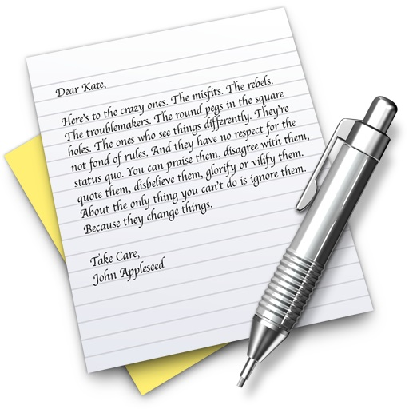

Data Representation
The topic this chapter: how information is stored inside a computer
The kinds of things stored in a computer’s memory include
  numbers
  text
  drawings
  photographs and other images
  music and other audio
Obviously a very big topic
  we’ll focus on text
  even more specifically, on strings of letters
  (and not worry about formatting)

Slide 4
Data Representation Projects
We’ll first start by looking at basic techniques for encoding text
  how characters are stored in main memory (RAM) or secondary memory (disk, DVD, ...)
  also needed when transmitting text over a network (e.g. fetching a web site from a server)
  we’ll look at standard codes (ASCII and Unicode) for representing text
Then we’ll look at techniques used to detect errors
  where errors come from, why error detection is important
  simple techniques for determining when text has changed since it was first encoded
Finally we’ll look at a simple technique for text compression
  the goal is to use less space, to allow more information to be stored

Slide 5
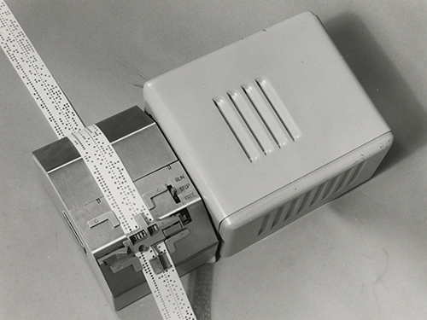
Bits
Computer memories are binary devices
The smallest unit of memory is called a bit (for “binary digit”)
Anything that has two states can potentially be used to store or transmit one bit of data
Mechanical devices
  beads on an abacus (up/down)
  relay switches (open/closed)
  paper tape or punch card (hole/not)

Slide 6
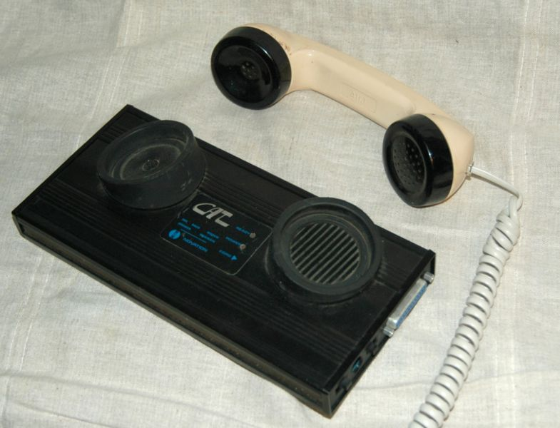
Bits
Magnetic devices
  core memories (clockwise/counter)
  magnetic tape
Electronic devices
  integrated circuits (0v / +5v)
  frequencies (low, high) in radio,
  telephone, ...
Optical devices
  use frequency or intensity of light

Slide 7
Bits
We’ll let computer engineers figure out the physical storage of bits
As computer scientists all we care about is that the memory device or communication channel distinguishes between two states
  by convention the states are labeled 0 and 1
Which state is 0 and which is 1 is arbitrary
  0 = 0v, 1 = 5v
  0 = off, 1 = on
  0 = no interference, 1 = interference
We just have to be consistent...

Slide 8
Encoding
To store information in a computer’s memory we have to encode it
  an encoding is a pattern of 1s and 0s
Terminology: the pattern is a representation of the real-world object
“I’m afraid of cows”
010010010010011101101011...
001000110000010000100000...
The original object is digitized to create a pattern of bits

Slide 9
Encoding vs Encrypting
Encoding is not the same
as encryption
In everyday English a “code”
is used to protect private or
sensitive information
In math and computer science
a code is simply a pattern
of bits
If we want the pattern to hide
information we use an
encryption algorithm to
scramble the code
Programmers also use the word “code” to mean “program”, as in
“Download the Pyrhon code from ...”

Slide 10
Groups of Bits
A byte is a collection of 8 bits
  before the 1970s the number of bits in a byte varied from system to system
  there were 6-, 7-, 8-bit bytes
  by the 1980s the term had become standard
A central processing unit (CPU) operates on several bytes at a time
  a word is a collection of two or more bytes
  typical word sizes are 32 bits (4 bytes) and 64 bits (8 bytes)
Memory capacity is often described in terms of megabytes or gigabytes
prefix | kilo- | mega- | giga- | tera- | peta-
meaning
abbreviation | KB | MB | GB | TB | PB

Slide 11
Data Representation
A single bit can represent any type of data that has only two values
  true or false (e.g. answers on a test)
    T = 1
    F = 0
  yes or no (e.g. votes on a referendum)
    Y = 1
    N = 0
To encode a type of data that can have more than two values we need to use a pattern of two or more bits

Slide 12
ASCII Codes
A set of k bits can represent up to 2^{k} different items
  1 bit: 0, 1
  2 bits: 00, 01, 10, 11
  3 bits: 000, 001, 010, 011, 100, 101, 110, 111
The ASCII code (an old standard for text files) is a 7-bit code
  with 7 bits there are 2⁷ = 128 distinct combinations of 0s and 1s
  sufficient to represent upper and lower case letters, digits, punctuation
Adding one bit doubles the number of patterns...
wikipedia.com

Slide 13
BitLab
The PythonLabs module for this chapter’s projects is named BitLab
  >>> from PythonLabs.BitLab import *
The module defines a class named Code
  to make a Code object pass the constructor a character or integer, it will return the corresponding binary code
  >>> Code(5)
  101
  >>> Code(19)
  10011
  >>> Code('a')
  1100001
  >>> Code('#')
  0100011

Slide 14
Aside: Hexadecimal and Binary
The binary representation for a string can be hard to read
  01001001 00100111 01101101 00100000 01100001 01100110 01110010 01100001 01101001 01100100 00100000 01101111 01100110 00100000 01100011 01101111 01110111 01110011 00101110
It’s a little easier to deal with codes in hexadecimal (base 16):
  49 27 6D 20 61 66 72 61 69 64 20 6F 66 20 63 6F 77 73 2E
The ASCII table from Wikipedia shows codes in binary, octal (base 8), and hexadecimal (base 16) as well as decimal

Slide 15
Hex Codes in BitLab
BitLab defines a class named Hex for showing codes in hexadecimal
  >>> Hex(42)
  2A
  >>> for ch in "hello":
  ... print(Hex(ch))
  ...
  68
  65
  6C
  6C
  6F

Slide 16


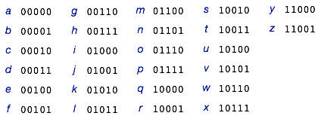
An Important Formula
If a set has n items, the number of bits required to represent an element of the set is
  each item in the set can then be assigned a unique pattern of k bits
Examples:
  4 nucleotides in DNA (A, C, G, or T): 2 bits per letter
  a choice of 6 colors: 3 bits per color (two patterns unused)
  a lower case letter: 5 bits (6 patterns unused)

Slide 17
Codes for a Set of Objects
A function named make_codes will generate codes for items in a list
  it figures out how many bits are needed, based on the number of items
  each item is assigned a unique code
Example:
  >>> a = ["white", "yellow", "red", "green", "blue", "black"]
  >>> len(a)
  6
  >>> from math import ceil, log2
  >>> ceil(log2(len(a)))
  3
  >>> make_codes(a)
  {'red': 010, 'yellow': 001, 'white': 000, 'black': 101, 'green': 011, 'blue': 100}
Each string has its own 3-bit binary code

Slide 18
Unicode
ASCII is sufficient for most American English text
How can we represent letters from other languages? or special symbols used in math and science?
A newer code, called Unicode, addresses these issues
Unicode 9.0 (June 2016) has codes for 135 alphabets
  modern languages (Greek, Cyrillic, Arabic, Hebrew, Chinese, Japanese, Korean, …)
  ancient languages (hieroglyphics, runes, …)
  technical symbols
  emoji

Slide 19
Unicode in Python
Here are three ways to include a Unicode symbol in a Python string:
(1) copy and paste text from a e-mail, a web page, etc
(2) use a function named chr (short for “character”)
  pass it a code number, it will return a one-letter string containing that symbol
  >>> chr(9829)
  '♥'
  find code numbers at www.charbase.com or similar sites that have lists of Unicode symbols
(3) use an escape sequence \uXXXX where XXXX is the 4-digit hexadecimal code number
  >>> msg = "I \u2665 cats"
  >>> msg
  'I ♥ cats'

Slide 20
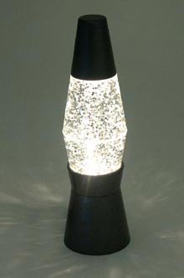

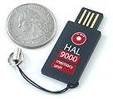
Source of Errors
Where do errors come from? Do we really need to be concerned about losing information?
One source of errors is in the storage medium
  magnetic tapes or diskettes can be corrupted by ringing phones
  or, in a more modern context, data on magnetic strips on cards can be scrambled by proximity to cell phones
  CDs can be scratched (it appears they also just deteriorate with age!)
  flash memory will start to wear out
  (after 10,000 updates)
USB Lava Lamp
www.thinkgeek.com

Slide 21

Sources of Errors (cont’d)
Errors can be introduced when information is transferred to or from the storage medium
Example: storing or fetching a file on an
internal hard drive
  disks are mechanical devices
  to read or write data the controller waits
  until the sector rotates around to the
  read/write “head”
  if the timing is off the data transfer
  is likely to have errors
  e.g. the head might start reading just
  a little bit too late so the first byte is
  not read properly

Slide 22

Sources of Errors (cont’d)
Data can be corrupted while it is in transit
  phone lines, DSL, other audio lines may be noisy
  optical connections have their own types of errors
  satellite and radio communications are very susceptible to interference
Each of these source of errors
may change single bits randomly
spread through the document,
or modify large chunks of the
document

Slide 23
Communication
The general method for detecting errors is to add extra information to a piece of text
  add extra data to a document before storing it in a file
  append error checking data to a message while sending it
In the remaining slides we’ll use terminology from data communications to describe error detection/correction, but the same ideas apply to file storage
The general outline:
  a sender adds error checking
  information
  after reading the message, the
  receiver analyzes the message
  along with the extra data to see if
  an error occurred
sender
receiver

Slide 24
Parity
The simplest method for error checking is to use a parity bit
  add one extra bit to the end of the text
  here “text” means any string, e.g. an entire message or a single character
The value of the extra bit should make the total number of ‘1’ bits an even number
Example: parity bits for ASCII characters
  A = 01000001
  there are two 1 bits, so attach a 0 as the parity bit (the total remains two)
  C = 01000011
  there are three 1 bits, so attach a 1 as the parity bit (bringing the total to four)
Example: parity bit for a piece of DNA (using ASCII)
  ATG = 01000001 01010100 01000111 + 1

Slide 25
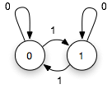
Calculating Parity: FSA
One way to compute the value of a parity bit is to use a “finite automaton”
  the initial state is state 0
As the message is being sent,
the machine changes state
according to bits being transmitted
After the last bit in the message,
send one additional bit,
defined by the current state
of the automaton
  example: after sending 01000001
  (ASCII ‘A’) send 0
  after sending 01000011 (ASCII ‘C’)
  send 1

Slide 26
Calculating Parity: FSA (cont’d)
The receiver will have its own automaton
  it also starts in state 0
As the message is being read,
this machine changes state
according to the bits it receives
When the message ends:
  if the machine is in state 1
  an error occurred
  if the machine is in state 0
  the message had an even
  number of bits; assume no
  error occurred (but note two
  bits may have changed...)

Slide 27
Parity Bits in BitLab
  >>> s = “hello"
  >>> c0 = Code(s[0])
  >>> c0
  1101000
  >>> c0.add_parity_bit()
  >>> c0
  11010001
  >>> c1 = Code(s[1])
  >>> c1
  1100101
  >>> c1.add_parity_bit()
  >>> c1
  11001010
The Code class, introduced earlier, returns the bit pattern for a number or character
A call to add_parity_bit attaches the parity bit at the right end

Slide 28
Processing the Parity Bit
The receiver treats the parity bit like any other bit in the incoming message
  the parity bit causes a state transition
  it is included in the count of the number of 1 bits
To get the message contents the receiver throws away the last bit
Example:
  when sending an ASCII ‘C’ the bit stream is 010000111 -- the digits in the code for ‘C’ plus a parity bit
  the receiver reads 9 bits and sees there were an even number of 1 bits -- no error
  throw away the 9th bit
  the remaining bits are the contents of the message: 01000011, which is the ASCII code for ‘C’

Slide 29

Communication Protocol
For this plan to work the sender and receiver
both have to agree on a communication protocol
  the protocol defines a message structure
  in our simple protocol the sender and receiver
  agree in advance the parity bit is the last bit
A convenient way to think about this process:
  the sender puts the message in an “envelope”
  the sender writes the value of the parity bit on
  the envelope
  the receiver checks the parity of the contents
  and the envelope
  after deciding there were no errors the receiver
  can discard the envelope and use the contents
  of the message
1
1

Slide 30
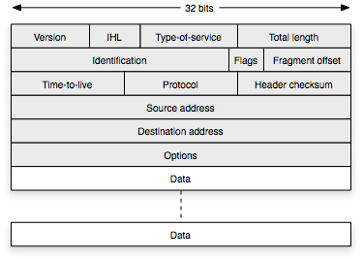
Communication Protocol (cont’d)
This general idea of including extra bits on an “envelope” is how communication protocols are defined
  TCP/IP (the internet protocol)
  includes routing information
  and much more
  the drawing at right shows
  all the extra information added
  to an “IP packet”
  the sender puts 6 or more
  words at the front of a packet
  the receiver examines the
  header, checks for errors,
  then throws away the
  envelope

Slide 31
Back to Parity Bits
The receiver knows an error occurred somewhere in the bit stream if the total number of 1 bits is odd
The receiver does not know where the error occurred
  it could have been the parity bit itself...
An even number of 1 bits does not guarantee there were no errors
  if two bits changed the total number of 1 bits will be even
Example:
  sender transmits 010000111
  receiver sees 001000111
  2nd and 3rd bits changed, but
  the message looks OK to the
  receiver

Slide 32
Experiments with Messages
BitLab has a function named encode
  pass it a string, it returns a list of ASCII codes (in the form of Code objects)
An optional argument named with_parity tells the function to attach parity bits to the codes
  >>> encode('AU')
  [1000001, 1010101]
  >>> encode('AU', with_parity=True)
  [10000010, 10101010]

Slide 33
Simulating Errors
To do experiments with codes, we can use a function named garbled to add random errors to a message
  another function, named decode, will translate a list of codes back into a string
  if a code has a parity error it is translated as a bullet symbol
  >>> message = "cows"
  >>> transmitted = encode(message, with_parity=True)
  >>> transmitted
  [11000110, 11011110, 11101110, 11100111]
  >>> received = garbled(transmitted, 1)
  >>> received
  [11000110, 11011110, 11100110, 11100111]
  >>> decode(received)
  'co•s'
The arguments passed to garbled are a message (list of Codes) and the number of errors to add
Can you find the error in the received message?

Slide 34
Multiple Errors
The second argument passed to garbled is the number of errors to create
  >>> msg = encode("aloha", with_parity=True)
  >>> msg
  [11000011, 11011000, 11011110, 11010001, 11000011]
  >>> test1 = garbled(msg, 3)
  >>> test1
  [11000111, 11011000, 11111110, 11010001, 11000111]
  >>> decode(test1)
  ‘•l•h•’
  >>> test2 = garbled(msg, 5)
  >>> test2
  [11101011, 11010010, 11011110, 11110001, 11000011]
  >>> decode(test2)
  'uio•a'
Do you see how the receiver was fooled into thinking there were no errors when 2 bits changed in a single code?

Slide 35
Computing the Parity Bit
Deciding whether to attach a 1 or a 0 to the end of a code is simple using a logic function called “exclusive or”
  normally “a or b” is true if either a or b is true
  the “exclusive or” of a and b is true if either is true but not both
Here is the truth table:

Slide 36
Computing the Parity Bit (cont’d)
A function that computes a parity bit is shown below
  initialize the return value p to 0
  iterate over all the bits in the input code, updating p using the exclusive OR operator
  if a bit is 0 it won’t change p, but if it’s a 1 it sets p to the opposite value

Slide 37
Text Compression
For very large strings we can save a lot of space by compressing the text
Our next project:
  an alternative scheme for encoding letters
  use shorter codes for more common letters
There are other algorithms for compressing files (including photos, images and other types of data) but we’ll focus on a simple plan for text only

Slide 38
Sequence Databases
To illustrate alternate codes we’ll use some examples from bioinformatics
Many important molecules in biochemistry are polymers
  these are long chains of smaller molecules
  DNA or RNA: chain of nucleotides
  protein: chain of amino acids
We can represent a polymer by using one letter for each element in the chain
  a DNA sequence (e.g. a chromosome) is a string made of A, T, C, and G
  a protein sequence is a string made from an alphabet of 20 letters (A, C, D, E, ...)

Slide 39

More Compact Codes
For most text ASCII is a good choice
  wide variety of letters and symbols
  easily stored in computer memory (one letter = one byte)
For sequence databases ASCII can be very inefficient
Example:
  DNA sequences have only
  A, C, G, and T
  a special-purpose code
  that uses just 2 bits for
  each letter would require
  1/4 as much memory
  e.g. 575,000 bytes instead
  of 4,600,000 for the E. coli genome
Nucleotide | Code
A | 00
C | 01
G | 10
T | 11

Slide 40
More Compact Codes
A special code for protein sequences would need 5 bits per letter
  there are 20 amino acid letters
  2⁴ = 16, so 4 bits don’t provide enough combinations
  2⁵ = 32 combinations
  A = 00000
  C = 00001
  D = 00010
  etc

Slide 41
Variable Length Codes
Another way to save space is to create a code based on letter frequencies
A variable-length code uses fewer bits for more common letters
To construct a variable length code we need to know how often each letter occurs in the data
  this table of letters and their frequencies was made by scanning protein sequences in a database of eukaryotes (plants and animals)
A | 0.069 | G | 0.063 | M | 0.023 | S | 0.083
C | 0.021 | H | 0.025 | N | 0.041 | T | 0.054
D | 0.05 | I | 0.048 | P | 0.058 | V | 0.06
E | 0.069 | K | 0.059 | Q | 0.047 | W | 0.011
F | 0.038 | L | 0.094 | R | 0.056 | Y | 0.031
least common
most common

Slide 42
Variable Length Codes
A code based on these letter frequencies:
  A ➟ 1011 G ➟ 1001 M ➟ 00100 S ➟ 1110
  C ➟ 101011 H ➟ 00101 N ➟ 11011 T ➟ 0100
  D ➟ 0011 I ➟ 0001 P ➟ 0110 V ➟ 1000
  E ➟ 1100 K ➟ 0111 Q ➟ 0000 W ➟ 101010
  F ➟ 11010 L ➟ 1111 R ➟ 0101 Y ➟ 10100
A | 0.069 | G | 0.063 | M | 0.023 | S | 0.083
C | 0.021 | H | 0.025 | N | 0.041 | T | 0.054
D | 0.05 | I | 0.048 | P | 0.058 | V | 0.06
E | 0.069 | K | 0.059 | Q | 0.047 | W | 0.011
F | 0.038 | L | 0.094 | R | 0.056 | Y | 0.031

Slide 43
Variable Length Codes
A code based on these letter frequencies:
  A ➟ 1011 G ➟ 1001 M ➟ 00100 S ➟ 1110
  C ➟ 101011 H ➟ 00101 N ➟ 11011 T ➟ 0100
  D ➟ 0011 I ➟ 0001 P ➟ 0110 V ➟ 1000
  E ➟ 1100 K ➟ 0111 Q ➟ 0000 W ➟ 101010
  F ➟ 11010 L ➟ 1111 R ➟ 0101 Y ➟ 10100
Note the most common letters are encoded with 4 bits, the least common with 6 bits
Examples of sequences represented with this new code:
  MSLTK ➟ 00100 1110 1111 0100 0111
  NWQEEL ➟ 11011 101010 0000 1100 1100 1111
When these codes are stored in memory the bits are all pressed together and then divided into bytes
  MSLTK ➟ 00100111 01111010 00111xxx

Slide 44
Efficiency
Does a variable-length code save any space?
  it depends on whether the text being stored has the same distribution of letters used to generate the code
Example:
  suppose a strange type of DNA is expected to have 92.5% A’s
  the other three letters are all expected to occur 2.5% of the time
  a variable length code based on these frequencies:
  A ➟ 1 C ➟ 011 G ➟ 00 T ➟ 010
  (we’ll see how this code was generated later in this lecture)

Slide 45
Efficiency
For a sequence with 10,000 bases that does in fact have 92.5% A’s:
  (9250 × 1) + (250 × 3) + (250 × 2) + (250 × 3) = 11,250 bits
  A: 1 C: 011 G: 00 T: 010
  compare to 2 × 10,000 = 20,000 bits for the fixed-length code
  compare to 8 x 10,000 = 80,000 bits for ASCII text file
But what if the text has a more typical distribution?
E. coli genes:
  A = 24.2%, C = 24.5%, G = 27.3%, T = 24.0%
  a set of 10,000 letters taken from this file would be encoded with
  (2420 × 1) + (2450 × 3) + (2730 × 2) + (2400 × 2) = 20,310 bits
So using the wrong frequency might be worse than using a fixed-length code (but still better than 8-bit ASCII)

Slide 46
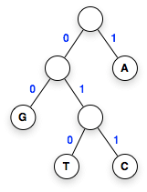
Huffman Tree
The codes on the previous slide were defined by a Huffman tree
A Huffman tree is a type of binary tree
  circles represent nodes
  connections between nodes are
  labeled with bits
  the root is at the top of the diagram
  (no nodes above it)
  leaves are at the bottom
  (no nodes below them)
  there is one leaf for each letter in
  the alphabet
The path from the root to a leaf
defines the code for that letter
A: 1 | T: 010
C: 011 | G: 00

Slide 47
Encoding a String of Letters
To encode a string just concatenate
the codes of each letter
Examples:
  ATG ➟ 101000
  GATTACA ➟ 00101001010111
A: 1 | T: 010
C: 011 | G:00

Slide 48
Decoding a Sequence of Bits
Finding the string of letters defined
by a bit sequence is known as
decoding
To decode a bit sequence:
  start at the root of the tree
  follow the path indicated by
  successive bits
  when you reach a leaf write
  down the letter
  if there are bits left repeat
  from step 1
Examples:
  0101011 ➟ TAC
  001001 ➟ GAGA
A: 1 | T: 010
C: 011 | G:00

Slide 49


Generating a Huffman Tree
There is a simple and elegant algorithm for generating a Huffman tree
Start by making a list that contains a leaf node for each letter
  include the letter’s frequency with the node:
  sort the nodes so the least frequent letters are at the front of the list:

Slide 50

Generating a Huffman Tree (cont’d)
Repeat until there is only one node left in the list:
  remove the first two items (call them n1 and n2)
  make a new node (call it n) that will be an interior tree node:
    n1 and n2 will be the children of n
    the frequency of n is the sum of frequencies of n1 and n2
    label the connection to n1 with 0 and the connection to n2 with 1
  insert n back into the list (keeping the list sorted by frequency)
Note the list shrinks by
one node on each step:
remove two, insert one

Slide 51

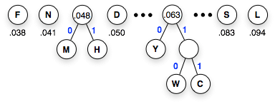
Generating a Huffman Tree (cont’d)
The next two steps of the example:

Slide 52

In-Class Project
Let’s do one as a group, using the data from the strange RNA
Here’s the initial list of leaf nodes:
Do we end up with the
tree shown earlier?

Slide 53


Huffman Trees in BitLab
A Node object represents a single node in a Huffman tree
To make a leaf node pass the constructor a letter and its frequency:
  >>> t1 = Node('T', 0.025)
  >>> t1
  ( T: 0.025 )
  >>> t2 = Node('C', 0.025)
  >>> t2
  ( C: 0.025 )
To make a new interior node pass references to existing nodes:
  >>> t3 = Node(t1, t2)
  >>> t3
  ( 0.050 ( T: 0.025 ) ( C: 0.025 ) )

Slide 54
Sample Data
The BitLab module includes data sets that can be used to experiment with the Huffman tree algorithm
Call read_frequencies to get a dictionary with letters and their frequencies
Example: get the amino acid letters and their frequencies:
  >>> aa = read_frequencies(path_to_data('aafreq.txt'))
  >>> aa['M']
  0.023
Other data sets are hafreq.txt (Hawaiian alphabet) and hvfreq.txt (vowels in Hawaiian words)

Slide 55
Priority Queue
The key to the Huffman tree algorithm is the data structure used to hold the tree nodes
  the list of nodes is initialized with leaf nodes for each letter
  as the program runs two nodes are removed and replaced by a new interior node
The data structure should be a list that is always sorted
  removing two items always removes the two lowest frequency nodes
  inserting an item always places it in the correct location so the list remains sorted
A list that is always sorted is called a priority queue
  queue here means “line” -- first in, first out
  high priority items -- in this case low frequency nodes -- cut to the front of the line

Slide 56
Priority Queues in BitLab
The BitLab module includes a new data type called PriorityQueue
  >>> pq = PriorityQueue()
  >>> pq
  []
To insert an item into a queue, call the insert method
  >>> pq.insert(12)
  >>> pq.insert(17)
  >>> pq
  [12, 17]
  >>> pq.insert(6)
  >>> pq
  [6, 12, 17]
  >>> pq.insert(13)
  >>> pq
  [6, 12, 13, 17]
A queue looks like a list when it is printed in the terminal window
Notice how items automatically move to their proper locations in the queue

Slide 57
Initializing the Queue
A function named init_queue will initialize a priority queue for the Huffman tree algorithm
  pass it a dictionary of letters and their frequencies
  the function will make a new Node object for each letter
  it will make a new PriorityQueue and insert each Node
Example, using amino acid letter frequencies:
  >>> aa
  {'D': 0.05, 'G': 0.063, ..., 'K': 0.059}
  >>> pq = init_queue(aa)
  >>> pq
  [( W: 0.011 ), ( C: 0.021 ), ..., ( L: 0.094 )]
The Node objects with the lowest frequency are at the front of the queue

Slide 58
Displaying the Queue
A function named view_queue will draw a PriorityQueue object on the PythonLabs canvas
  >>> pq
  [( W: 0.011 ), ( C: 0.021 ), ( M: 0.023 ), ( H: 0.025 ), ...]
  >>> view_queue(pq)
NOTE: the current version of view_queue assumes items in the queue are Huffman tree Node objects

Slide 59
Removing Items from the Queue
Call a method named pop to remove the first item in the queue
  >>> n1 = pq.pop(); print(n1)
  ( W: 0.011 )
  >>> n2 = pq.pop(); print(n2)
  ( C: 0.021 )
The deleted nodes move down, out of the queue

Slide 60
Making a New Interior Node
It’s easy to combine the two nodes we just removed into a new node and insert the new node into the queue:
  >>> n = Node(n1, n2); print(n)
  ( 0.032 ( W: 0.011 ) ( C: 0.021 ) )
  >>> pq.insert(n)
Note the frequency of the new node is the sum of the frequencies of its children

Slide 61
Putting It All Together
To continue building the tree, combine the three steps into a single Python statement:
  >>> n1 = pq.pop(); n2 = pq.pop(); pq.insert(Node(n1,n2))
Now you can just use command line editing to repeat that statement as many times as you need to build the complete tree
  hit the up arrow and then the return key to repeat the previous step
If there are n items in the initial queue, how many rounds of removing-and-combining are required to complete the tree?
n-1
What is the frequency in the node at the root of the completed tree?
Quiz
1.0

Slide 62
A Function that Builds a Huffman Tree
The steps from the previous slides have been collected into a function named build_tree

Slide 63
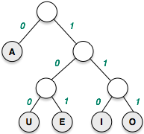
Assigning Binary Codes
In the BitLabs implementation, binary codes are defined after the tree is built
  >>> vtree = build_tree(path_to_data("hvfreq.txt"))
  >>> hc = assign_codes(vtree)
  >>> hc
  {'A': 0, 'U': 100, 'O': 111, 'E': 101, 'I': 110}
This example uses the letter frequencies for vowels in Hawaiian words

Slide 64
File Compression in Practice
File compression applications are very common
  Stuffit, others for Mac and PC
  zip, compress for Unix (including Linux and OS/X)
File compression also works on music, images, and many other types of data
  jpeg, gif, and other image formats are compressed from original image data
Example: the compress program for Unix systems
  % ls -l NC_000913.gbs
  -rw-r--r-- 1 conery 5998130 May 10 12:33 NC_000913.gbs
  % compress NC_000913.gbs
  % ls -l NC_000913.gbs.Z
  -rw-r--r-- 1 conery 1669141 May 10 12:33 NC_000913.gbs.Z

Slide 65
Some Examples
A research paper (mostly English, with lots of markup symbols)
  uncompressed: 40,773 bytes
  compressed: 17,991
  reduced version is 44.1% the size of the original
E.coli feature table (English text, with very regular structure and lots of repeated phrases):
  uncompressed: 5,998,130 bytes
  compressed: 1,669,141
  27.8%
PDF document (mostly binary data)
  uncompressed: 5,417,058 bytes
  compressed: 5,060,755
  93.4% -- very little reduction in size

Slide 66
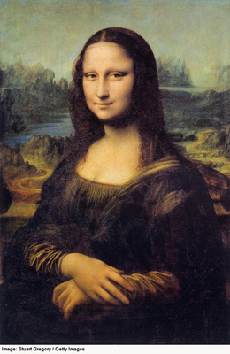
Lossless Compression
Data compression for images or music
often throws away information
  e.g. MP3’s are “good enough” for
  ring tones or iPods
  JPEG files are OK for photos on
  web pages
  users are often willing to sacrifice
  music or image quality to save space
The text compression algorithms
described here allow us to
recover all the information in
the original document --
no data is lost

Slide 67
Summary
The main topics for this chapter:
  encoding translates symbols (letters, digits, bases, ...) into sequences of bits
  decoding recovers symbols from bit sequences
  ASCII codes (8 bits per character) are the default choice for text files
  a parity bit can be added to a character to help determine if the character changed since it was stored or transmitted
  text can be compressed by using alternate encodings
  special-purpose codes can be designed for an application (e.g. 2-bit code for DNA)
  variable-length codes are based on letter frequencies
  the Huffman tree algorithm can be used to generate variable-length codes

